Slide 1
A PRESENTATION ON-
SKEWNESS & KURTOSIS
Dr. Srinibash Dash
School of Management
Gangadhar Meher University
Sambalpu Dr. Srinibash Dash
School of Management
Gangadhar Meher University

Slide 2
TOPICS TO BE DISCUSSED
INTRODUCTION TO SKEWNESS & KURTOSIS
SIGNIFICANCE OF SKEWNESS & KURTOSIS
APPLICATIONS OF SKEWNESS & KURTOSIS
MATHEMATICAL CALCULATION
MS-EXCEL CALCULATIONS FOR SKEWNESS& KURTOSIS

Slide 3
INTRODUCTION
SKEWNESS
Literally refers to “LACK OF SYMMETRY”.
Determines the nature & extent of the concentration of the observations towards the higher or lower values of collected data.
KURTOSIS
The statistical method which measures the “FLATNESS OR PEAKEDNESS” of the frequency curve is known as kurtosis.
The degree of kurtosis is studied by comparing its peakedness with that of a normal distribution.

Slide 4
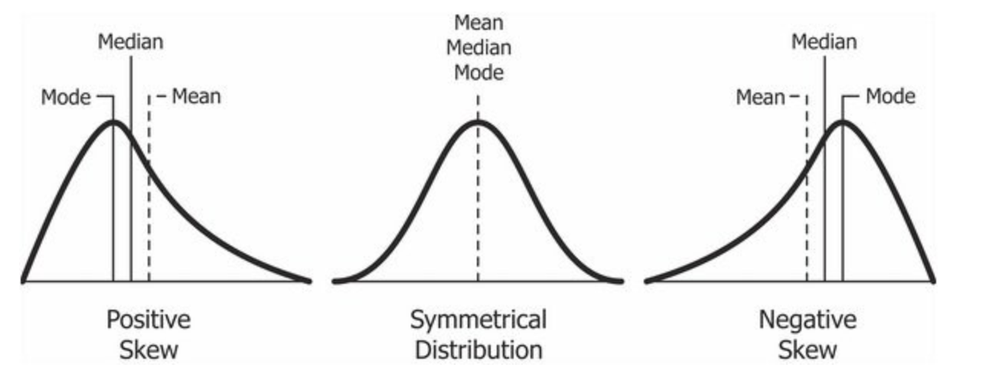
TYPES OF SKEWNESS
POSITIVELY SKEWED
NEGATIVELY SKEWED
NO SKEWNESS

Slide 5
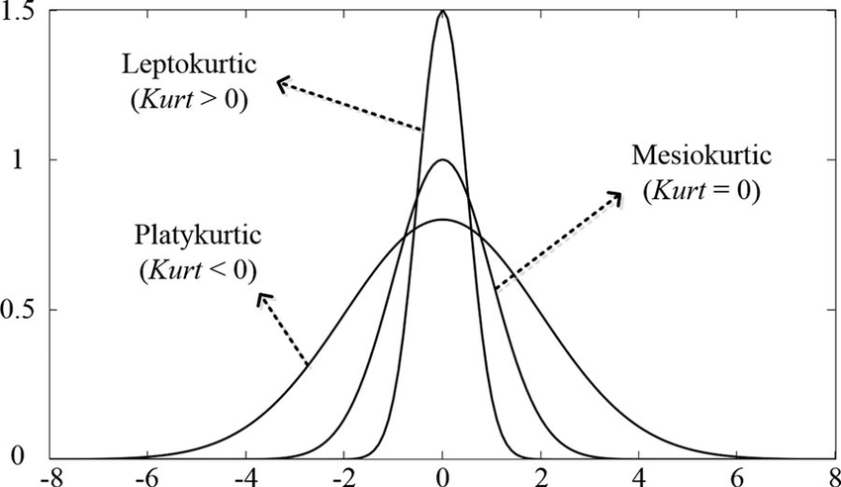
TYPES OF KURTOSIS
MESOKURTIC
LEPTOKURTIC
PLATYKURTIC

Slide 6
MEASURES OF SKEWNESS
KARL PEARSON’S MEASURE
BOWLEY’S MEASURE
(Mean-mode)
3(Mean-Mode)/S.D
(WHEN MODE IS ILL DEFINED)
Co-efficient= Mean-Mode/S.D
LIMIT= +3 TO-3
Q3+Q1-2median
Co-efficient=Q3+Q1-2Median/Q3-Q1
LIMIT= +1 TO-1

Slide 7
MEASURE OF KURTOSIS
The only measure of kurtosis is introduced by KARL PEARSON.
It is based on central moments( moments of mean).
Co-efficient of kurtosis= FORTH MOMENT/S.D
=Summation(X-A)4/N

Slide 8
SIGNIFICANCE
SKEWNESS:-
It shows the manner in which the items are clustered around the average.
In a symmetrical distribution, the items show a perfect balance on either side of the mode, but in a skewed distribution the balance is thrown in one side.
KURTOSIS:-
Kurtosis decides the heaviness of the distribution tail.
It helps to understand where the most information is lying and analyse the outliers in a given data.
In finance, it is used as a measure of financial risk.

